Slide 1
Array
1-Dimensional Array in C
A 1-Dimensional array is a collection of elements of the same data type.
The elements are stored in contiguous (continuous) memory locations.
Each element in the array is accessed using an index.
The index starts from 0 and goes up to (n–1), where n is the number of elements.
It allows efficient storage and access of multiple data items of the same type.
The syntax for declaring a 1-D array is:

Slide 2
Syntex
int marks[5] = {85, 90, 78, 92, 88};
Initialization: int marks[5] = {90, 85, 88, 92, 76};
int marks[5] = {90, 85}; // remaining elements become 0
scanf("%d", &marks[2]);
for (i = 0; i < 5; i++)
scanf("%d", &marks[i]);

Slide 3
Lab 7. 1-D Array
Write a program to find the sum of an array.
Write a program to print the subarray that lies between the two indexes.
Write a program to reverse an array with an auxiliary array.
Write a program to find the largest and smallest element in an array.
Write a program to arrange the elements of an array in ascending order by a simple sorting method. (Selection sort/bubble sort)

Slide 4
1. SELECTION SORT
Concept:
Selection Sort repeatedly finds the smallest (or largest) element from the unsorted part and places it at the beginning.
Algorithm Steps (Ascending order):
Start with the first element (index 0).
Find the smallest element in the remaining array.
Swap it with the element at the current position.
Move to the next position and repeat until the array is sorted.

Slide 5
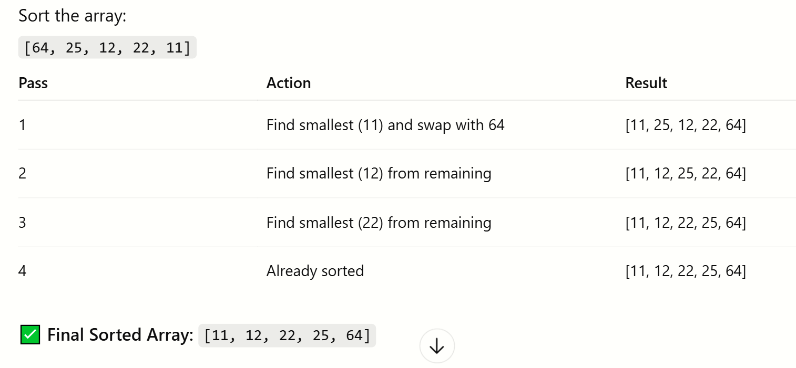

Slide 6
2. BUBBLE SORT
Concept:
Bubble Sort repeatedly compares adjacent elements and swaps them if they are in the wrong order.
Algorithm Steps (Ascending order):
Compare each pair of adjacent elements.
Swap if the first is greater than the second.
Repeat the process for all elements until no swaps are needed.

Slide 7
